Slide 1
schoenherr
Real Talk
sabine binder-krieglstein
director human resources

Slide 2
law firm phantasies

Slide 3
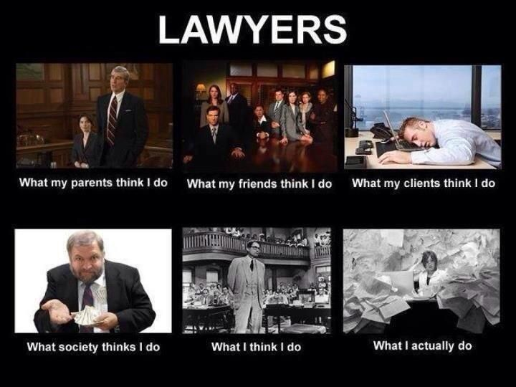
law firm phantasies

Slide 4
reality check
In der Großkanzlei bin ich sowieso nur eine Nummer. Das Individuum zählt da nicht.

Slide 5
reality check
Direkten Mandantenkontakt hast du erst mal ganz lange nicht.

Slide 6
reality check
Hier lassen sie das Licht brennen, damit die anderen glauben, man ist noch da.

Slide 7
reality check
Kandidat:innen aus Großkanzleien fallen bei der RAP sowieso zuerst einmal durch.

Slide 8
reality check
Man ist so hoch spezialisiert, dass man für die RAP praktisch nicht vorbereitet ist.

Slide 9
reality check
Partner:in wird dort sowieso keiner mehr.

Slide 10
reality check
Ohne einen Notendurchschnitt von 1,0 brauche ich mich gar nicht erst zu bewerben.

Slide 11
reality check
Es zählen nur die billable hours – Fortbildung oder wissenschaftliches Arbeiten hat keinen Platz.

Slide 12
reality check
Sie haben dort Duschen und Schlafbereiche, weil man tagelang nicht nach Hause kommt.

Slide 13
reality check
Einen Partner bekommt man persönlich nie zu Gesicht.

Slide 14
reality check
Als Frau hat man in einer Großkanzlei ohnehin keine Chance.

Slide 15
reality check
M&A? Banking? Finance?
Hatten wir nicht auf der Uni.

Slide 16
reality check
Privatleben? Kannst du vergessen.

Slide 17
reality check
Schönherr? Da komm ich nie rein.

Slide 20
legal notice
IMPORTANT NOTICE
This confidential presentation (the "Presentation") has been prepared by Schönherr Rechtsanwälte GmbH, any of its branch offices, subsidiaries or permanent cooperation partners ("Schoenherr"), for the recipient to which it was sent and/or presented by Schoenherr, and certain of that recipient's affiliates, for information and discussion purposes only. If this Presentation or its contents were made available to you without you being the intended recipient, please do not read, copy, use or disclose this Presentation to others. Also, please notify Schoenherr and destroy and/or delete this Presentation from your system.
Recipients of this Presentation should not treat the contents of this Presentation as a substitute for obtaining specific advice relating to legal, regulatory, commercial, financial, audit and tax matters, and are to make their own independent assessments concerning such matters. Neither this Presentation, nor any part of it, anything contained in it or referred to in this Presentation nor the fact of its distribution, should form the basis of or be relied on or act as a recommendation to pursue (or not to pursue) a particular course of action.
This Presentation does not purport to be all-inclusive or necessarily to contain all the information, steps etc. that are required for the legal advice which Schoenherr is Presenting for. Furthermore, this Presentation may be subject to updating, withdrawal, revision or amendment. No representation or warranty, express or implied, is or will be given by Schoenherr or any of Schoenherr's representatives, partners, counsels, lawyers, associates, employees, consultants, agents etc. as to the accuracy or completeness of this Presentation or the information or opinions contained therein.
This Presentation, its contents and any views expressed herein are strictly confidential and may also contain privileged information. Thus, it may not, directly or indirectly, be copied, distributed, published or reproduced, in whole or in part, or disclosed to any other person. Furthermore, Schoenherr does not transfer any intellectual property rights, including copyrights, in any documents or other materials in relation to this Presentation.
Schoenherr retains the right to request the return or destruction of this Presentation at any time.

